Slide 1


Slide 2


Intro to Mathematical Planning with F#
Matthew Crews

Slide 3
3 Big Questions

Slide 4




Slide 5



Slide 6


Slide 7
Quantifiable Objective
Constraints
Decisions

Slide 8


Slide 9
Mathematical Planning

Slide 10


Slide 11
What is Mathematical Planning?

Slide 12
What is Mathematical Planning?
The mathematical discipline of finding the values for a set of decisions which achieve the best possible outcome given a quantifiable objective and constraints to be adhered to

Slide 13
or…

Slide 14
The Mathematics of
caring for people

Slide 15


Slide 16
How do we do
Mathematical Planning?

Slide 17
Mathematical Planning Workflow
Build a Model
Submit Model to a Solver
Extract Decision Results

Slide 18
What Makes a Model
Sets : How your data is organized
Cities, Products, Time Periods, …
Parameters : The data which drives the model
Capacities, Demands, Production Rates, …
Decisions : The variables that can be adjusted
Number of people to assign, amount of money to invest, …
Constraints : The limits we must obey
Production limits, Budget Limits, Legal Limits, …
Objective: How we measure success
Maximize Profit, Minimize Cost, Minimize Waste, …

Slide 19


Slide 20
Power Generation Planning
Sets: Power Plants and Cities
Parameters: Cost for Generation, Cost for Transmission, City Power Demand, Generation Capacity
Decisions: How much power to generate where, how much to transmit
Constraints: Limits of power generation, cities must be powered
Objective: Minimize Cost

Slide 21


Slide 22
Logistics Planning
Sets: Packages to be shipped, delivery options
Parameters: Dimensions of packages, capacity of shipping methods
Decisions: Which method to ship packages
Constraints: Shipping methods are not overloaded, cost of shipping is not exceeded
Objective: Maximize On Time Delivery

Slide 23


Slide 24


Slide 25


Slide 26
Any time you have a problem with…
Quantifiable Objective
+ Constraints
+ Decisions
= Mathematical Planning

Slide 27


Slide 28
Vaccine Distribution Problem
We need to assign Trucks to carry vaccines to Cities
Each City has a different vaccine demand
Each Truck has a different capacity
There is a different cost for each Truck going to each City
We want the minimum cost plan

Slide 29
Our Data
let trucks = // list<string>
["TruckA"; "TruckB"; …; "TruckG"]
let cities = // list<string>
["Portland"; "Seattle"; "Los Angeles"]
let demand = // IDictionary<string, float>
dict ["Portland", 10_000.0
"Seattle", 15_000.0
"Los Angeles", 18_000.0 ]

Slide 30
Our Data
let capacity = // IDictionary<string, float>
dict ["TruckA", 7_000.0
"TruckB", 9_000.0
… ]
let costs = // IDictionary<(string * string), float>
dict [("Portland" , "TruckA"), 12_000.0
("Portland" , "TruckB"), 13_000.0
… ]

Slide 31
The Model
let assignment = // IDictionary<(string * string), Decision>
DecisionBuilder "Assign" {
for t in trucks do
for c in cities ->
Boolean
} |> dict

Slide 32
The Model
let truckAssignedOnceConstraints = // seq<Constraint>
ConstraintBuilder "SingleAssignment" {
for t in trucks ->
let totalAssignments =
List.sum
[for c in cities ->
1.0 * assignment.[t, c]]
totalAssignments <== 1.0
}

Slide 33
The Model
let cityDemandMetConstraints = // seq<Constraint>
ConstraintBuilder "CityDemand" {
for c in cities ->
let totalSupply =
List.sum
[for t in trucks ->
capacity.[t] * assignment.[c, t]]
totalSupply >== demand.[c]
}

Slide 34
The Model
let objectiveFunction = // LinearExpression
List.sum [
for c in cities do
for t in trucks ->
costs.[c, t] * assignment.[t, c]
]
let objective = // Objective
Objective.create "MinimizeCost" Minimize objectiveFunction

Slide 35
The Model
let model = // Model
Model.create objective
|> Model.addConstraints truckAssignedOnceConstraints
|> Model.addConstraints cityDemandMetConstraints
let result = // SolveResult
Solver.solve Settings.basic model

Slide 36


Slide 37


Slide 38
But why F#?

Slide 39


Slide 40


Two new features…

Slide 41
Domain Modeling and Units of Measure
type Truck = Truck of string
type City = City of string
[<Measure>] type Dose
[<Measure>] type Crate
[<Measure>] type USD
[<Measure>] type Load
let trucks = // list<Truck>
[Truck "TruckA"; Truck "TruckB"; …; Truck "TruckG"]
let cities = // list<City>
[City "Portland"; City "Seattle"; City "Los Angeles"]

Slide 42
Domain Modeling and Units of Measure
let demand = // IDictionary<City, float<Dose>>
dict [
City "Portland", 10_000.0<Dose>
… ]
let capacity = // IDictionary<Truck, float<Crate/Load>>>
dict [
Truck "TruckA", 7_000.0<Crate/Load>
…]

Slide 43
Domain Modeling and Units of Measure
let costs = // IDictionary<(City * Truck), float<USD/Load>>
dict [
(City "Portland", Truck "TruckA"), 12_000.0<USD/Load>
… ]
let assignment = // IDictionary<(Truck * City), Decision<Load>>
DecisionBuilder<Load> "Assign" {
for t in trucks do
for c in cities ->
Boolean
} |> dict

Slide 44
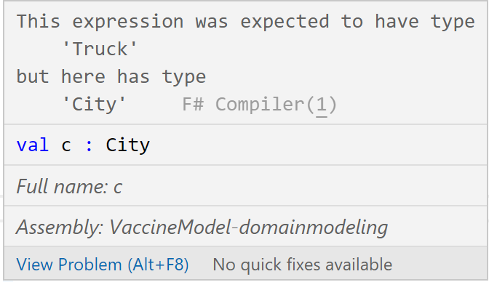
An Error Appears
let cityDemandMetConstraints = // seq<Constraint>
ConstraintBuilder "CityDemand" {
for c in cities ->
let totalSupply =
List.sum
[for t in trucks ->
capacity.[t] * assignment.[c, t]]
totalSupply >== demand.[c]
}

Slide 45
An Error Appears
let cityDemandMetConstraints = // seq<Constraint>
ConstraintBuilder "CityDemand" {
for c in cities ->
let totalSupply =
List.sum
[for t in trucks ->
capacity.[t] * assignment.[ , ]]
totalSupply >== demand.[c]
}
c
t

Slide 46


Slide 47
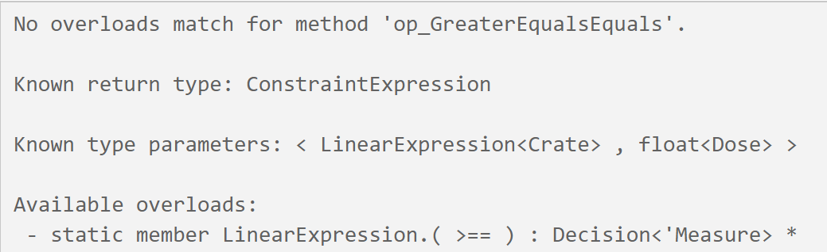
Another Error Appears
let cityDemandMetConstraints = // seq<Constraint>
ConstraintBuilder "CityDemand" {
for c in cities ->
let totalSupply =
List.sum
[for t in trucks ->
capacity.[t] * assignment.[t, c]]
totalSupply >== demand.[c]
}

Slide 48
Another Error Appears
let dosePerCrate = 100.0<Dose/Crate>
let cityDemandMetConstraints = // seq<Constraint>
ConstraintBuilder "CityDemand" {
for c in cities ->
let totalSupply =
List.sum
[for t in trucks ->
capacity.[t] * assignment.[t, c]]
totalSupply >== demand.[c]
}
dosePerCrate *

Slide 49
But why F#?

Slide 50




Slide 51
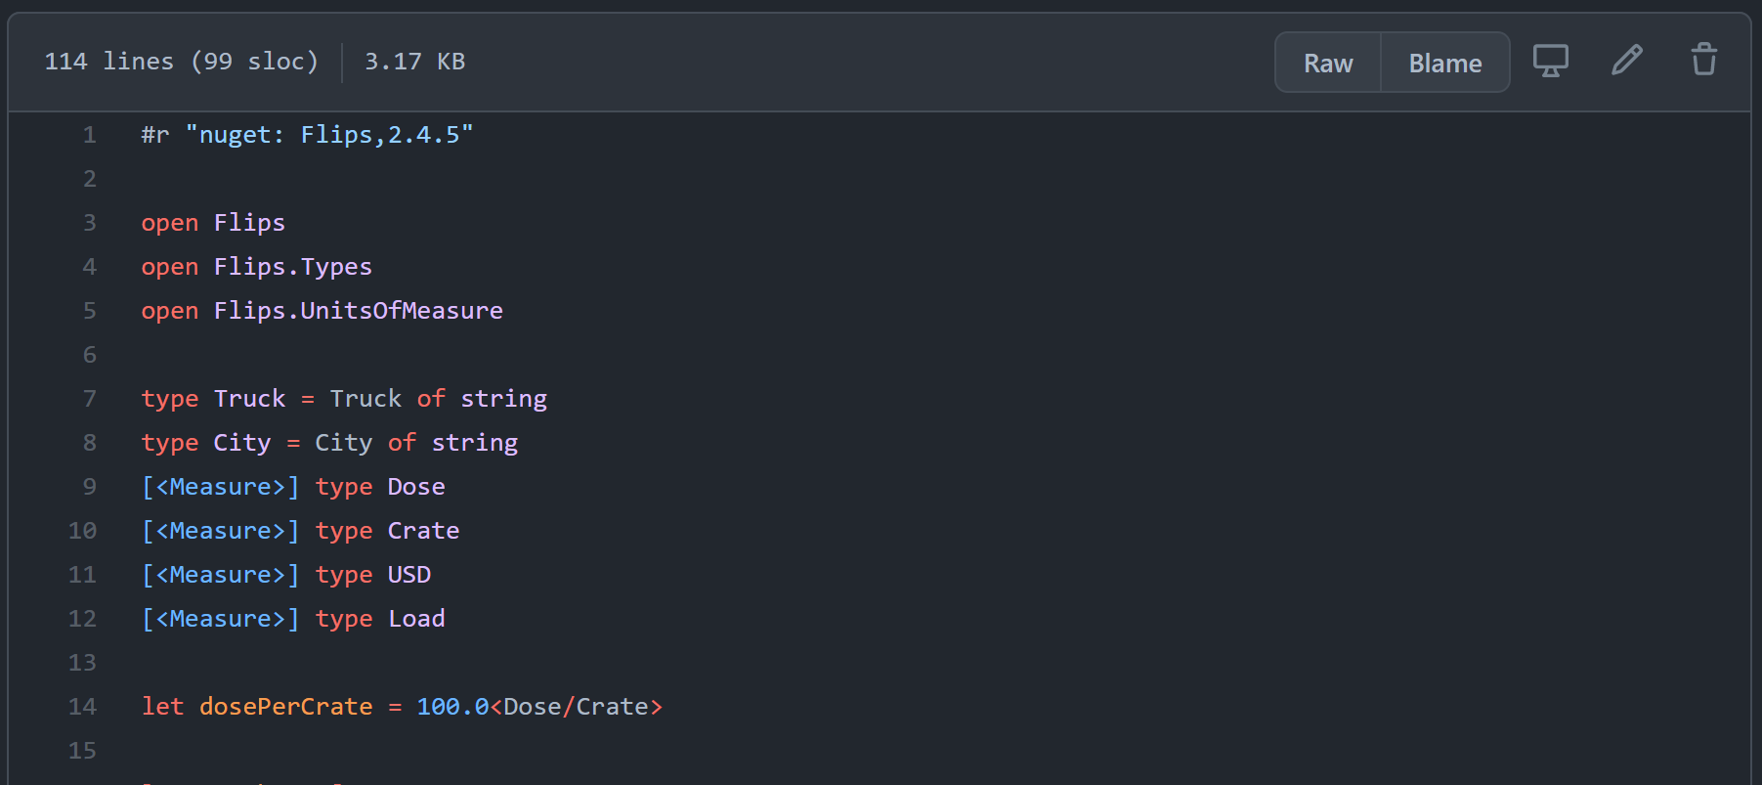
Full Example https://tinyurl.com/3j7963a9

Slide 52

flipslibrary.com

Slide 53

Thank you!
Matthew Crews
Mathematical Planning and Simulation
Full Example: https://tinyurl.com/3j7963a9
Website: matthewcrews.com
Twitter: @McCrews
GitHub: matthewcrews
Email: matthewcrews@gmail.com
F# Slack: mcrews

Slide 54

Thanks for joining!
Ask your questions live on Twitter #dotNETConf

